Slide 1
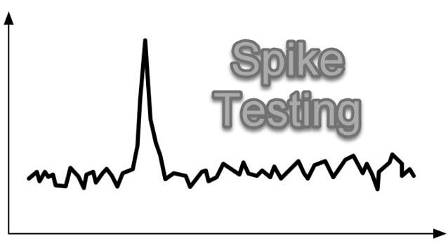
emp id :- 6148
Anudeep suragala

Slide 2
Spike testing is a type of performance testing in which an application receives a sudden and extreme increase or decrease in load. The goal of spike testing is to determine the behavior of a software application when it receives extreme variations in traffic.
If your stress test includes a sudden, high ramp-up in the number of virtual users, it is called a Spike Test.
During a spike test, testers may find that application performance worsens, slows or stops entirely. Determining what and where an application fails under spike tests allows for developers to better prepare for unexpected spikes in load while in production environments. For example, it would be a good idea to spike test an e-commerce application to prepare for Black Friday sales.

Slide 3
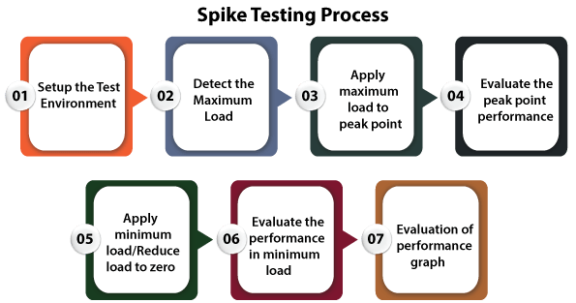

Slide 4
Spike Testing Tools :-
Apache JMeter
LoadRunner
Advantages:-
It regulates the software performance and also ensuring a good quality product
While performing the spike testing, we can easily sustain the system from crashing under the load's spikes.
Disadvantages:-
Spike testing required an independent testing environment.
To perform the spike testing, we need to set up special test conditions, which makes this process bit costlier.

